Slide 1
Enabling School Computing to respond to a skills mismatch between Education and the ‘World of Work’
Alison Twiner, Jo Shillingford,
Louis Major and Rupert Wegerif

Slide 2
Linking schools & enterprise
Educating for the future (‘future skills’) through real-world projects and authentic links with real ‘world of work’ contexts
‘Virtual’ team role-play – Virtual Internships
‘Complex competencies’:
communication, collaboration & teamwork
creativity & design
complex problem solving
Our ‘design-based-research’ will:
evaluate this new model
develop tried & tested educational design principles
develop a plan for a scalable, sustainable platform

Slide 3
Cumulative cost & effort
1) Planning & Preparation
2) Identifying & Resolving Risks
Progress
Analysis of situation:
existing theory
requirements
Review
Initial Design
Revised Design
Operational Design
~ 2 schools
Implications for theory
~ 2 to 4 schools
Up to 100 schools
4) Evaluation
Final practical & theoretical ‘products’
3) Implementation
Based on: Boehm, B. (1988). A spiral model of software development and enhancement. Computer, 21(5), 61-72.

Slide 4
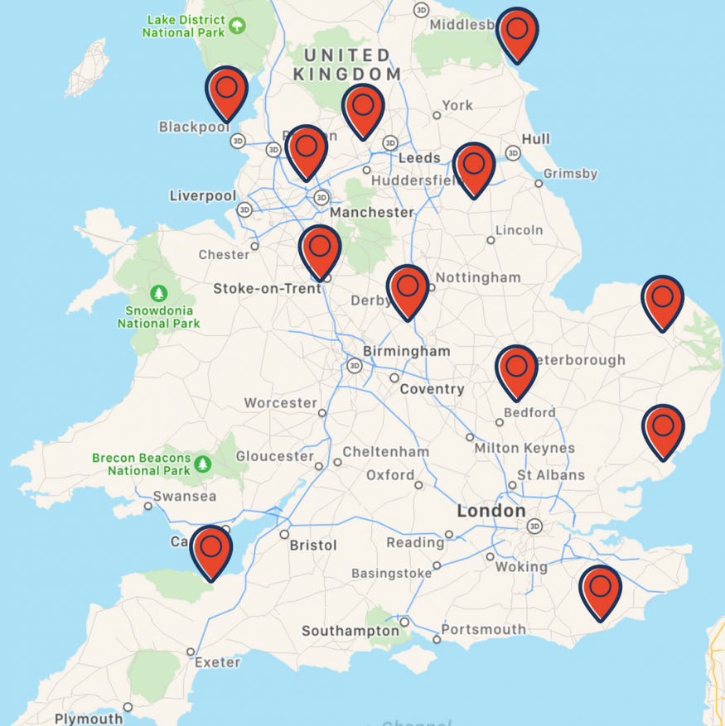

Slide 5
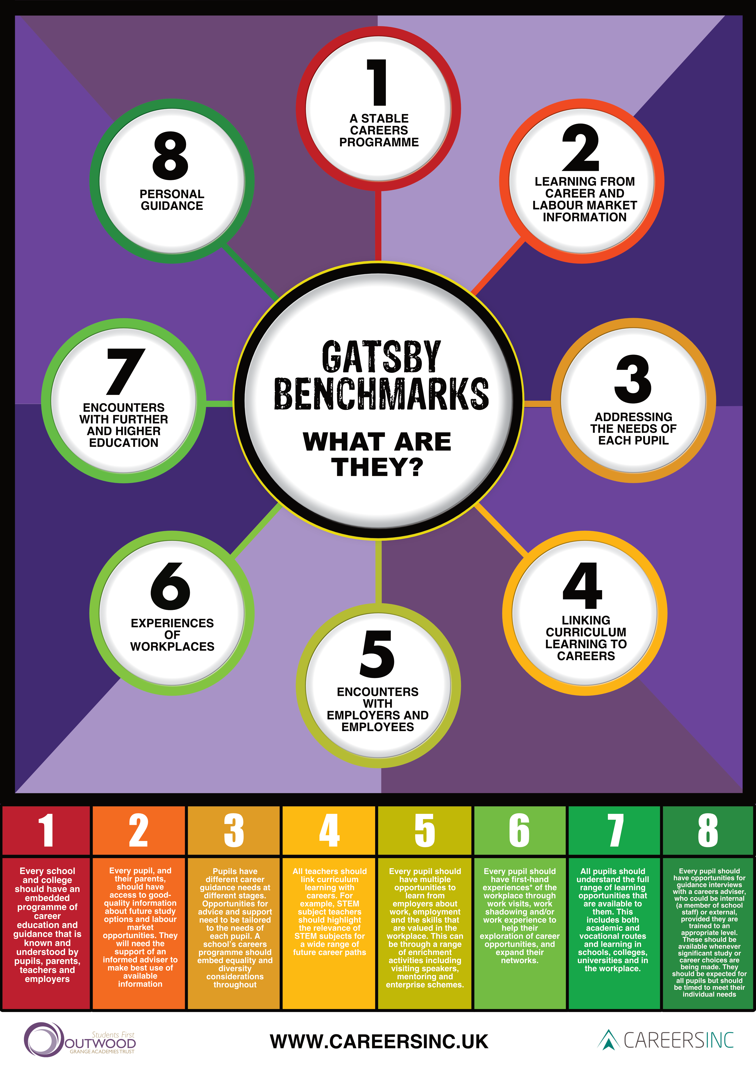
Source: www.careersinc.uk/delta-darton/policy-and-practice/

Slide 6
3) Authentic (curricula) link to the WoW
1) Challenge-Based Learning
2) Collaborating to Create (C2C)
= Virtual Internships
Phase One: Pedagogy & classroom application
Phase Two: Considering lessons, then developing a scalable ‘platform’

Slide 7
What is Challenge-Based Learning?
Focus on:
Real-world problem
A challenge that’s important to students
Computing foci: digital divides and connectivity
Meaningful use of technology
Teamwork
What VIP adds to this:
Support for teamworking: C2C
Authentic link to the world of work

Slide 8
‘Collaborating2Create (C2C)’
Education
Schools & curricula
School experiences & context
‘Collaborating2Create’ (C2C)
Group working
Dialogue
Problem-solving
Creating products or solutions
Being creative
World of work
Authentic workplace experiences
Educating for the future / future skills

Slide 9
Linking authentically to the ‘world of work’
Authentic ‘real-world’ challenges that are relevant to the Computing curriculum, around connectivity and digital divides
Video & audio (as a ‘hook’, illustration of workplace practices)
‘Thinking global, acting local’ = students are experts
Collaborating2Create = skills & competencies for the future
CSI Assessment Criteria

Slide 10
Where we’re at now…
Phase 1, Iteration 1 complete in ‘lead research schools’
Computing:
seven Year 8 classes in two schools;
five teachers;
200+ students.
Data includes
nine lesson observations;
three student focus groups;
58 surveys with students.

Slide 11
Voices from the classroom: Computing Teacher and Careers Leader perspective
Why I decided to take part
World of Work
Group work and ground rules
Challenge
Overcoming barriers
Gender difference – who doesn’t love Computing!
Positivity all around

Slide 12
C2C in the Computing class
Developing ‘Jaz Enterprises’ and ‘The Jaz One’
18.30: [Designing the prototype (L); using Scratch to demonstrate the interface (R)]
22.02
L: ‘Yes! I’m a genius!’
L [suggesting text to programme in]: ‘What time is Bingo tomorrow?’
23.10
L: ‘There we go, there’s our phone. It’s beautiful! Personally, I think that looks cool!’
22.15
R [liking the suggestion]: ‘Bingo!’
Notes:
Year 8 Computing class

Slide 13
29.15
L: ‘R – are you finished?’
R: ‘Let me save. I’m pretty much done. Do you want to test it?’
L: ‘Right can I play?’
[L and R swap seats]
28.11
L: ‘The Jaz phone TM’
R: ‘Put “The Jaz Phone”. That’s our name – Jaz Enterprises!’
L: ‘Jaz One!’
30.13
L [reads]: ‘Bob has gone shopping! Jim is not available right now!’
R: ‘I must have not put in …’
30.53
L: [typing] ‘Cheers Geoff… Oh you write back?’
[reading] ‘Are you free on Saturday? There is a coffee morning on’ [typing] ‘Yes’ [hits enter] ‘Hey it works!’
[reading] ‘Are you free to meet up sometime?’ [typing] ‘Ew, get away from me you creep!’
31.51
L: ‘Right, mail was the last one’ [types something in]
R [returning to seat]: ‘I need to fix that’

Slide 14
Summary of analysis
Shared ownership and affirming group identity
Individual work is combined, feeding in to each other’s tasks, to create a collaborative idea and product solution
Presenting to the class, 6 weeks later:
‘Our goal is to redesign the electronic industry and make it accessible to anyone. We plan to start this with our brand new Jaz phone’

Slide 15
Retrospective pre-post survey data
 | How I felt before starting my Virtual Internship (in September) | How I feel now having completed my Virtual Internship
I know some of the skills people need in the workplace | 1 2 3 4 5 | 1 2 3 4 5
I think I have some of the skills I will need in the workplace | 1 2 3 4 5 | 1 2 3 4 5

Slide 16
 | Mean score (pre) | Mean score (post)
What I learn and do in Computing will be important for me in the future | 2.93 | 3.96
I know some of the skills people need in the workplace | 3.6 | 3.86
I can reflect on what I’ve done well, and think about how I can improve my work | 3.60 | 4.23
I think I have some of the skills I will need in the workplace | 3.23 | 3.95
I think group work is important | 2.86 | 3.51
I feel confident to present my ideas to others | 3.18 | 3.81
I can think about problems in different ways | 2.93 | 3.82
I enjoy working in a group | 2.74 | 3.68

Slide 17
Next steps
Building on early successes from Phase 1: Iteration 1
Optimising the ‘Virtual’ intentions of the project
Developing a scalable model, through understanding of what works and why
Managing the balance between scope for flexibility and localisation, and need for structure and scaffolding

Slide 18
Contacts
Alison Twiner: ajt213@cam.ac.uk
Jo Shillingford: JShillingford@chellaston.derby.sch.uk
Louis Major: lcm54@cam.ac.uk
Rupert Wegerif: rw583@cam.ac.uk
https://www.educ.cam.ac.uk/research/projects/vip/

